Slide 1
Digital Awareness
A guide to social media & Internet

Slide 2
Social Media
How Important is the “digital sphere” in our lives?
Entertainment
Facebook
Twitter
Instagram
Snapchat
Periscope
YouTube
Mobile Games
Professional
LinkedIn
Google+
Pinterest

Slide 3
Digital Footprints
Just like walking your digital steps are left behind and traced!
Nothing “deleted” is ever truly gone – Ex. Snapchat
Once something is posted online, it is accessible to anyone
Be mindful of what you post
Family
Friends
Future Jobs
Future Schools
All posts have CONSEQUENCES!!!

Slide 4
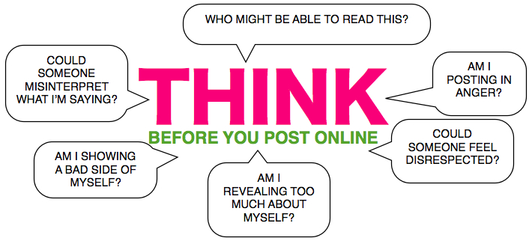

Slide 5
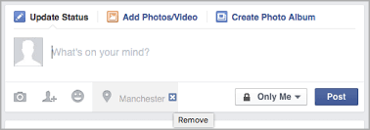
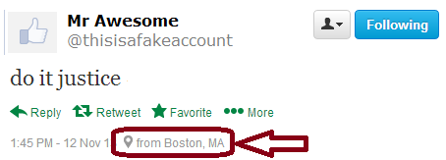
Digital Access
It is a privilege to use media and the internet
Apps / programs may have rights to your posts / comments
Possibly be banned or suspended from using certain applications
LOCATION LOCATION LOCATION!
Apps use location-based services when roaming – similar to GPS in phone
Examples: Facebook and Twitter

Slide 6
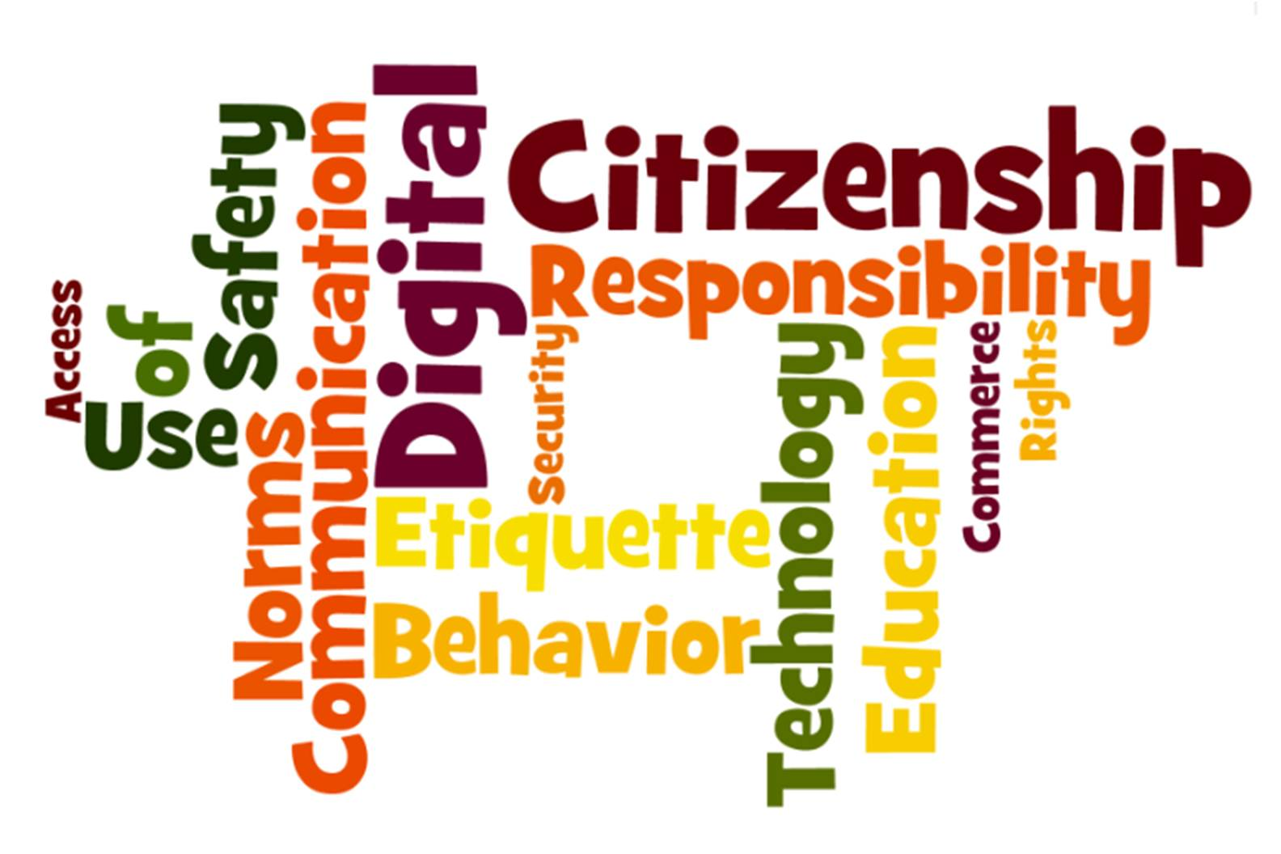
Digital Citizenship
Appropriate and responsible use of technology
Courteous use of social media
NO cyber bullying or harassment
Knowledge of scams and attempts to infect your computer
If any of the above are “broken,” legal action can and may be used against the individual

Slide 7
Appropriate Use?
Group discussion: What are appropriate uses of media?
Effective posts / status
Images of Positive Activities and Behavior
Means of good communication – call, chat, text, etc.
Accomplishments
LinkedIn – Professional App for job/education profile
(Job database search engine and opportunities)

Slide 8
Legal: Back from the Past! - Myspace
Cases have involved students directly mocking school officials. In 2005 high school senior Justin Layshock (Hermitage HS) made a MySpace profile to mock his principal, and was suspended. His parents decided to sue, and they prevailed in a Third Circuit decision, which found no reason to consider the site a material disruption.
Similar case – A PA middle school student created another parody MySpace profile for her principal. The school’s suspension was upheld in two court decisions – school could lawfully punish “vulgar, lewd, and potentially illegal speech on campus.”

Slide 9
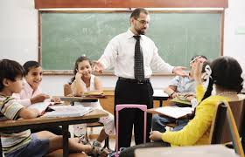
Result?
Both courts were at the same time and determined by same court – the following year the courts overturned the decisions, both in favor for the student, finding the schools discipline violated the student’s First Amendment Rights.
Thoughts – How did this act effect the student AND other parties involved (Principals, etc.)?
Personal Image!

Slide 10
College / Future Jobs
Search Engine for media (Google, etc.)
View friends as well (all friends!)
Images / posts / comments
Check likes and favorited pages
Personal Information
Applications – may ask questions involving social media and/or platforms being used

Slide 11
Digital Awareness Plan
WE ARE RISING!
Be here, be ready, be safe, be respectful!!!
“Know your surroundings!”
Friends
Family members
Co-workers
New Acquaintances
Think before you Post / Comment
Is this an act of being aggravated or an arguable comment?
Will others be offended or affected by this comment?

Slide 12
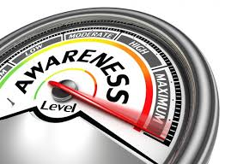
Review – Check your Footprints
Complete the given worksheet
Rate yourself on your personal footprint
Now: With a partner review the following scenarios of digital awareness
Then: Class discussion of results

